Slide 1


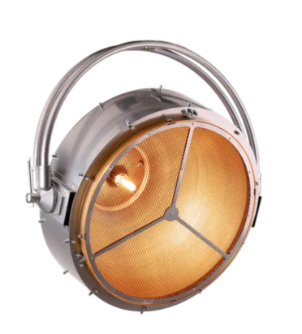
www.harrythehirer.com.au
www.facebook.com/harrythehirer_productions
@harrythehirer_productions
#busyharry
Robe Patt 2013
Patt 2013 is the first in a series of retro style lighting – designed specifically to further the current trend for tungsten eye-candy on stage and set - for bands, television, film and general prop lighting.
Physical
Size of Unit – 691 x 695 x 324
Item Weight – 7.2kg
Quantity in Case –
Size of Unit Cased –
Cased Weight –
Electrical
Rated Power - 750 W
Input Power – 120 V or 240 V, 50/60 Hz
Power Connection – IEC power cord
Mounting Options
M12 mounting for clamp or spigot
Universal operating position
Optical
Colour Temperature – 3.050 K
Light source type – High Performance Tungsten Lamp
Base – G 9,5 special (with heat sink)
Recommended lamp type – HPL 750/240/X 750W - 240V, HPL 750/120/X 750W - 120V
Lifetime: 1.500 hours

Slide 2
Control
Mains input –
115 V for HPL 750/115 V LAMP
120 V for HPL 750/120 V LAMP
230 V for HPL 750/230 V LAMP
240 V for HPL 750/240 V LAMP
Environmental
IP Rating – IP20
Cooling – Convection
Max Operating Temperature – 45 degrees
Suitability
Backdrops on stage for eye candy look
Camera looks
Light with ring control
Information Links
User Manual User_manual_PATT_2013_EU.pdf
Data Sheet 682

Slide 3
